Slide 1


General course
2022-2023
Database
joins
Serhat Erdogan

Slide 2
Goals of this lesson
Student understands how to work with Left join.
Student understands how to work with Right join.
Student understands how to work with Outer join.

Slide 3
Recap: give an overview of all fines
Give an overview of all the names of the players who have a fine and the amount of the fine.

Slide 4
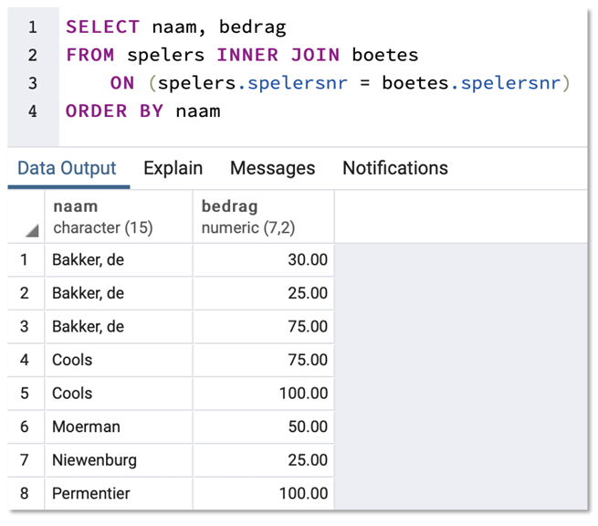
Recap: give an overview of all fines

Slide 5
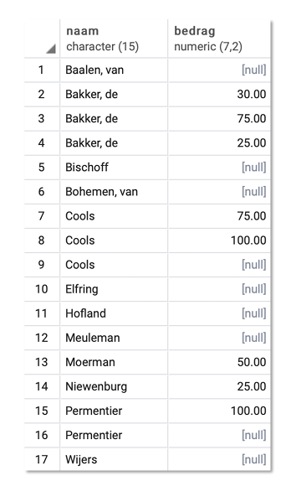

What if I also need the memebers with no fine?

Slide 6
Outer join
All rows from 1 or more tables are witheld
SELECT naam, bedrag
FROM spelers LEFT OUTER JOIN boetes using(spelersnr)
ORDER BY naam
Notes:
Change the order of the tables to explain right join

Slide 7
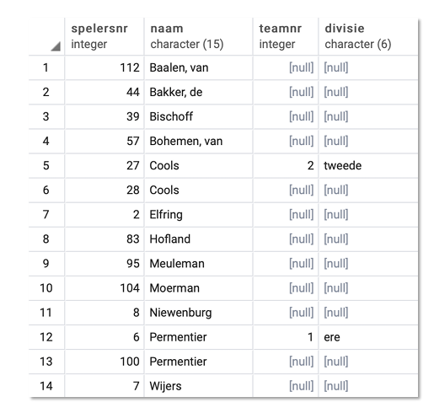
Exercise
Make a list of all players (number and name). If a player is a captain of a team, then also list the team number and the team’s division.

Slide 8
Different possibilities
LEFT OUTER JOIN:
all rows from left-side table are kept, when no join, then null
RIGHT OUTER JOIN:
all rows from right-side table are kept, when no join, then null
FULL OUTER JOIN:
all rows from both tables are kept

Slide 9
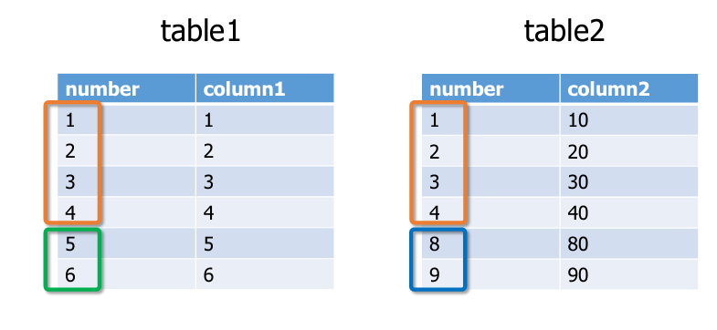
Example

Slide 10
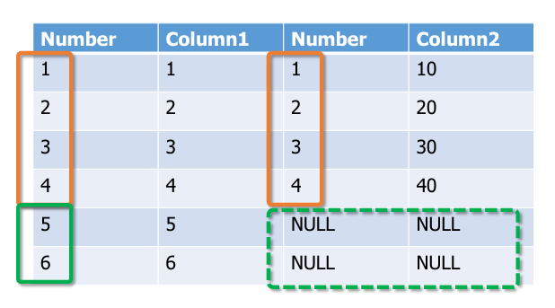
Table 1 LEFT OUTER JOIN Table2

Slide 11
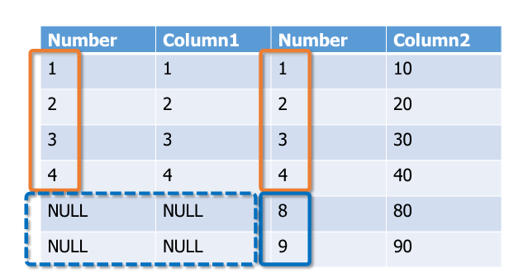
Table 1 RIGHT OUTER JOIN Table2

Slide 12
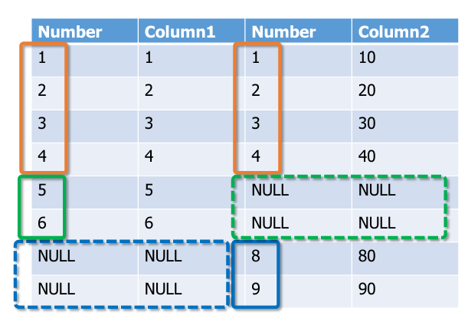
Table 1 FULL OUTER JOIN Table2

Slide 13
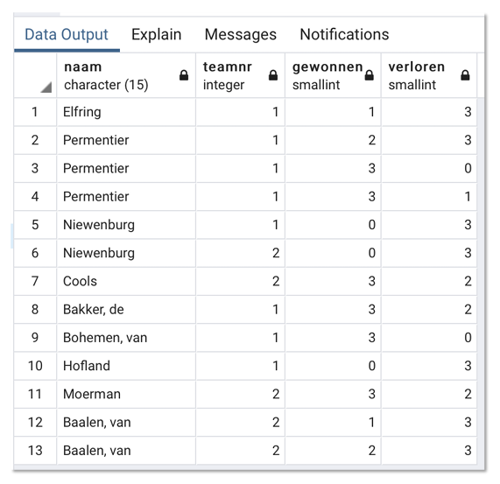
Exercise
Display for each member (spelers) an overview of the games he or she played (wedstrijden).
Output: name (naam) of the member and for each game the team number and the result.

Slide 14
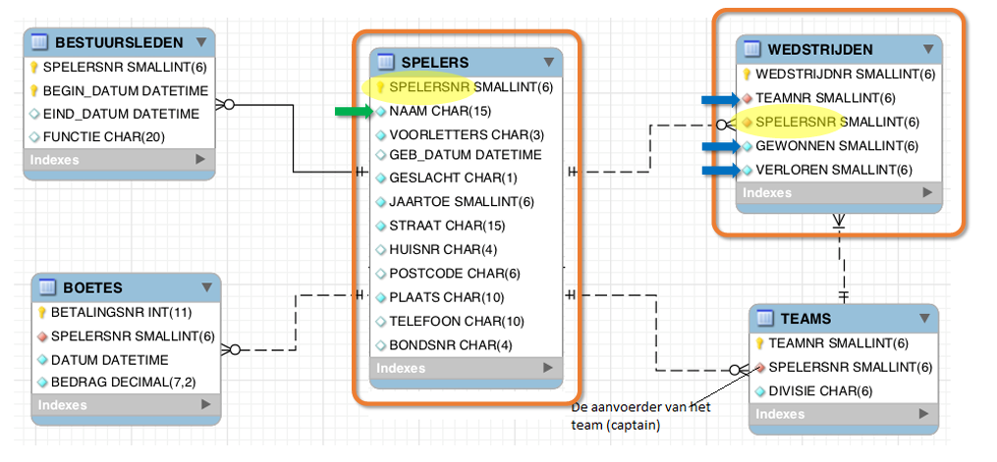
ERD

Slide 15
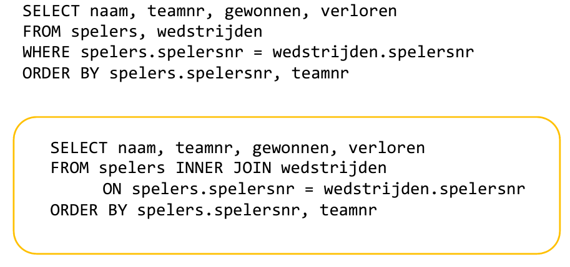
Solution

Slide 16
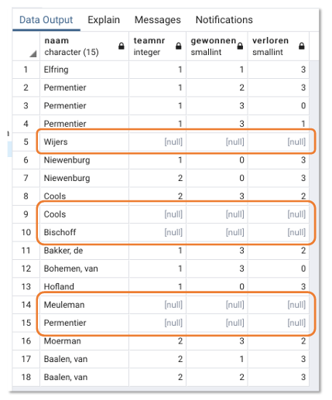
Extension
Same exercise, but now show all members (spelers), also those not playing games.

Slide 17
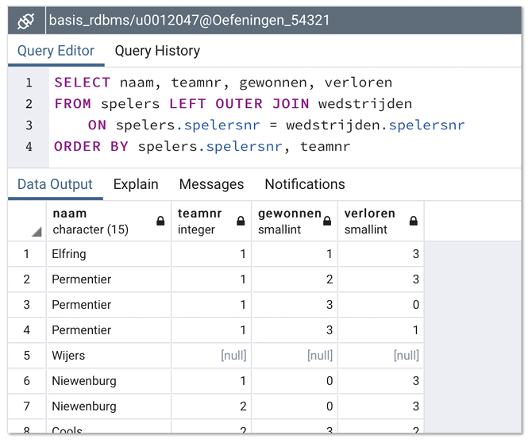
Solution

Slide 18
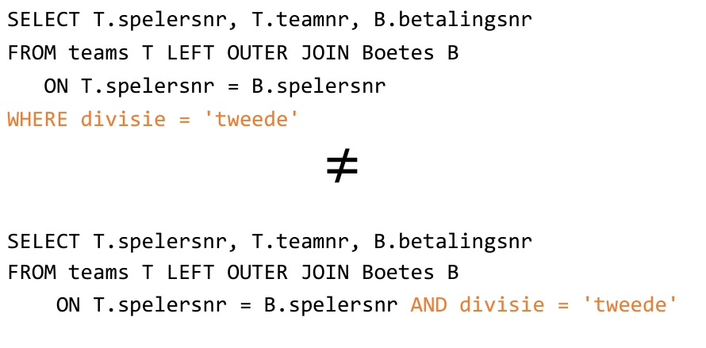
Extra conditions in join condition

Slide 19
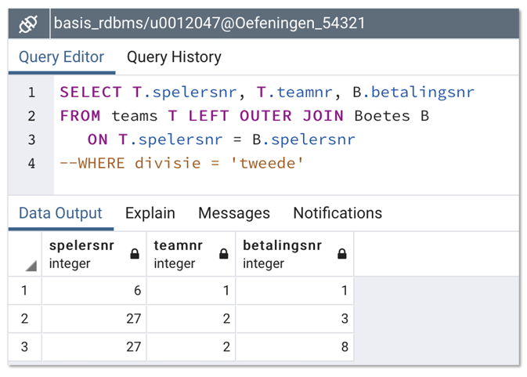
Intermediate result 1ste query

Slide 20
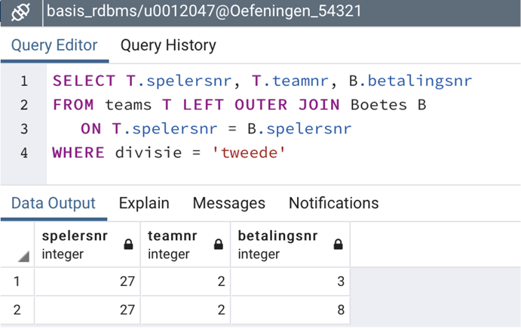
Finale result 1ste query
Notes:
https://stackoverflow.com/questions/354070/sql-join-where-clause-vs-on-clause

Slide 21
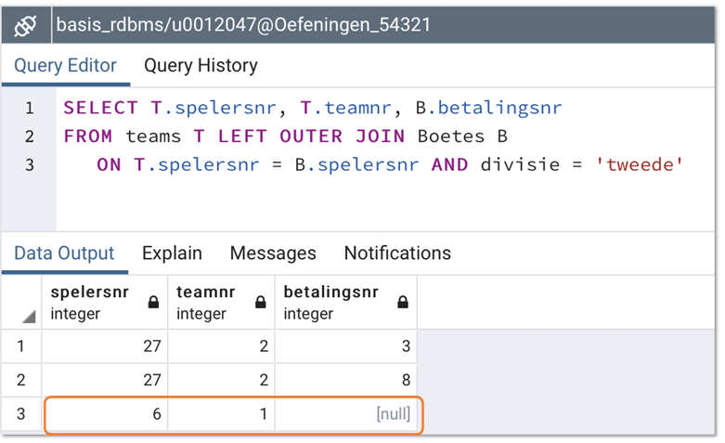
End result 2de query

Slide 22
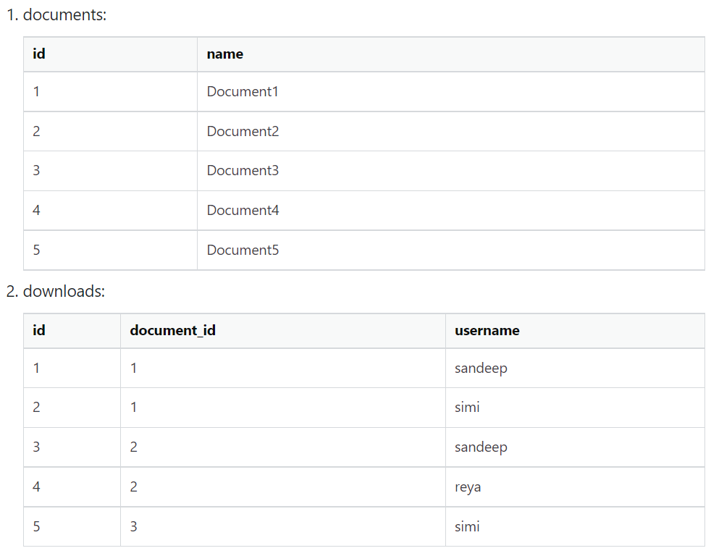
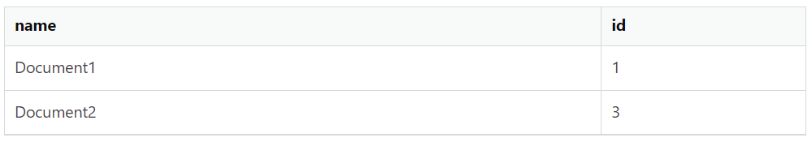
Example condition where
SELECT documents.name, downloads.id
FROM documents LEFT OUTER JOIN downloads
ON documents.id = downloads.document_id
WHERE username = 'sandeep'

Slide 23
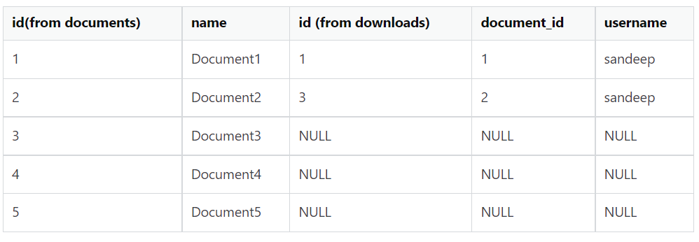
Example condition on
SELECT documents.name, downloads.id
FROM documents LEFT OUTER JOIN downloads
ON documents.id = downloads.document_id
and username = 'sandeep'

Slide 24
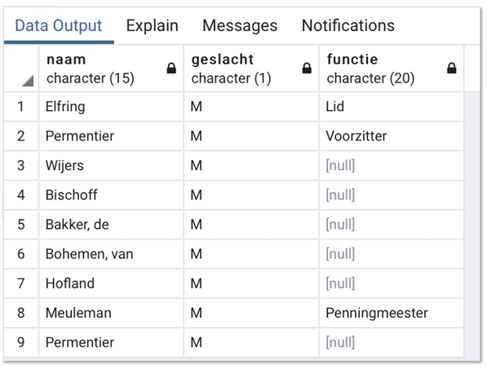
Difficult exercise
Give for each male player (spelers) an overview of all functions he has at this moment. Sort by spelersnr. Include players currently without a function in the board.

Slide 25
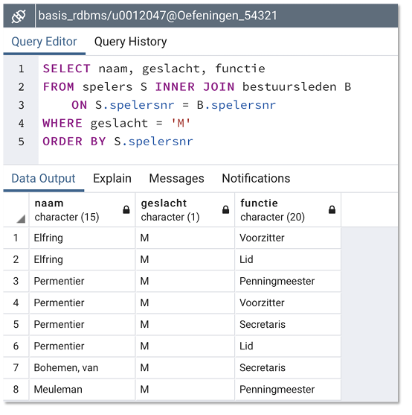
Wrong 1

Slide 26
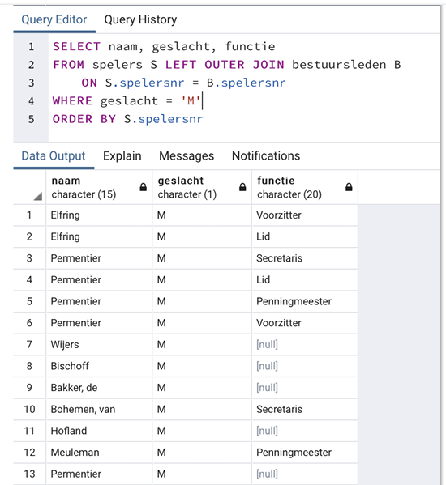
Wrong 2

Slide 27
